Slide 1

Scouting and Guiding at University:
The Student Scout and Guide Organisation
<Date / Time>
<Event / Occasion>
Notes:
Add on when you’re doing the presentation and for what event / occasion

Slide 2

WHO’S WHO?
<Name>
<Club / SSAGO Exec>
<Role>
<Name>
<Club / SSAGO Exec>
<Role>
<Name>
<Club / SSAGO Exec>
<Role>
<Name>
<Club / SSAGO Exec>
<Role>
<Name>
<Club / SSAGO Exec>
<Role>
<club abbreviation> = <club name>, the <city / location> based SSAGO club
Notes:
Add photos of those that are presenting / representing SSAGO
If using club abbreviations, let people know what it means

Slide 3
SSAGO
WHO?
WHY?
WHAT?
The Student Scout & Guide Organisation - a national and non uniformed organisation of over 1000 members and over 45 clubs
We enable you to continue or begin your Scouting or Guiding journey whilst at College or University.
Nationally we have 4 events per year – 3 national camps and an annual ball. Clubs do their own activities.
WHEN?
WHERE?
HOW?
SSAGO clubs generally meet at least once a week during term time
There are clubs in many Universities across the country with some clubs covering more than one university.
Clubs have their own society committees.
National Executive Committee.
Representative system.
Notes:
Figures on members and clubs may not be up to date

Slide 4
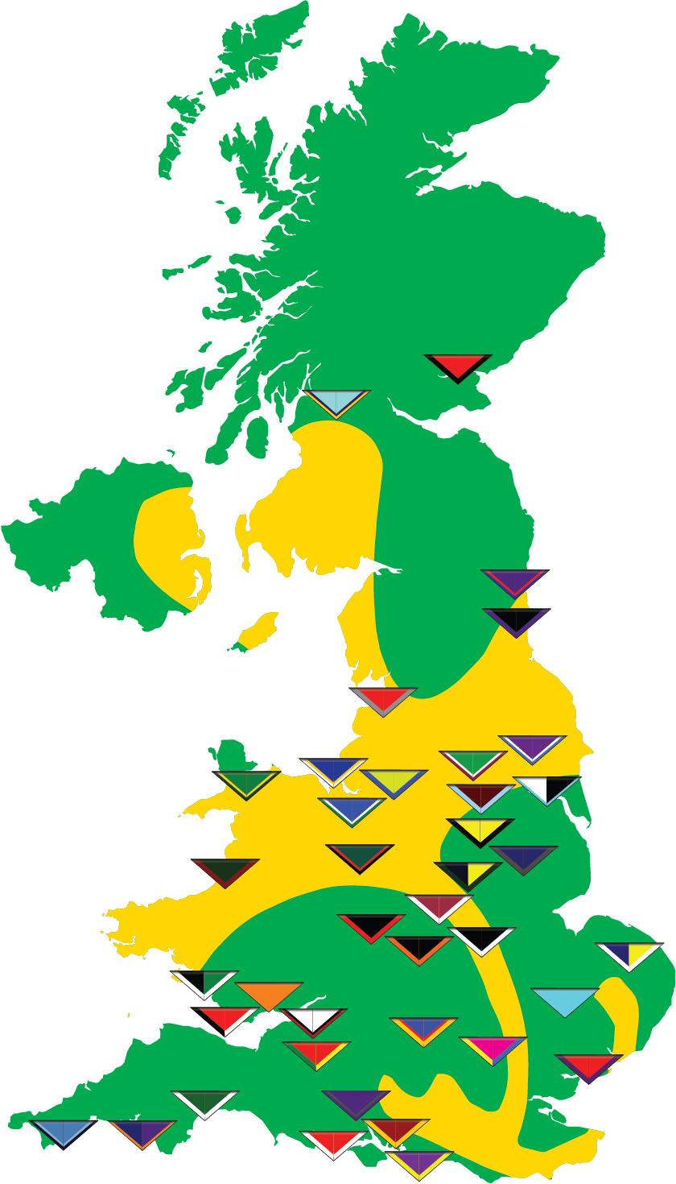
UNIVERSITIES AND COLLEGES COVERED BY SSAGO
Aberystwyth University
Anglia Ruskin University
Aston University
Bangor University
Birmingham City University
Bishop Grosseteste University College Lincoln
Cardiff Metropolitan University
Cardiff University
De Montfort University
Edge Hill University
Glasgow Caledonian University
Leeds Beckett
Leeds College of Art
Leeds College of Music
Leeds Trinity University
Liverpool Hope University
Liverpool Institute for Performing Arts
Liverpool John Moores University
Loughborough University
Newman University College
Northern School of Contemporary Dance
Nottingham Trent University
Oxford Brookes University
Royal Conservatoire of Scotland
Royal Holloway and Bedford New College
Royal Northern College of Music
Royal Welsh College of Music and Drama
Sheffield Hallam University
Southampton Solent University
Swansea University
The Glasgow School of Art
The Manchester Metropolitan University
The Robert Gordon University
The University of Bolton
University College Birmingham
University College Falmouth
University of Aberdeen
University of Abertay Dundee
University of Bath
University of Birmingham
University of Bristol
University of Cambridge
University of Cumbria (Lancaster Campus)
University of Derby
University of Dundee
University of Durham
University of East Anglia
University of Essex
University of Exeter
University of Glasgow
University of Hertfordshire
University of Hull
University of Keele
University of Lancaster
University of Leeds
University of Leicester
University of Lincoln
University of Liverpool
University of Manchester
University of Newcastle upon Tyne
University of Northumbria at Newcastle
University of Nottingham
University of Oxford
University of Plymouth
University of Portsmouth
University of Salford
University of Sheffield
University of South Wales
University of Southampton
University of Strathclyde
University of the West of England, Bristol
University of the West of Scotland
University of Wales
University of Wales Trinity St David
University of Winchester
University of Worcester
University of York
York St John University
Notes:
Clubs at over 80 universities across the UK
Note: map not up-to-date, list updated 24/05/2020
https://www.ssago.org/clubs/map

Slide 5
WHO CAN JOIN SSAGO?
SSAGO is open to all students studying at a higher education establishment in the UK, both colleges and universities

Slide 6
WHY WE DO WHAT WE DO
The process of starting at university is often daunting for young people and we help to provide a sense of familiarity.
Provide members with the opportunity to take up leadership roles and gain experience in team and event management
SSAGO provides a platform for our members to volunteer with local Scout or Guide units.
SSAGO is something that helps members stay active within Scouting or Guiding whilst going through the busy and challenging times of university.
We provide our members with the opportunity to travel the country and make new friends.

Slide 7















NATIONAL SSAGO RALLIES AND BALLS

Slide 8
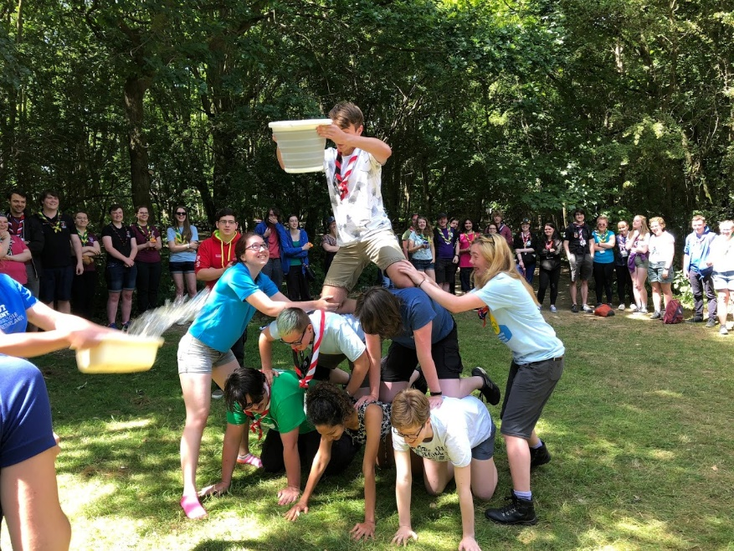
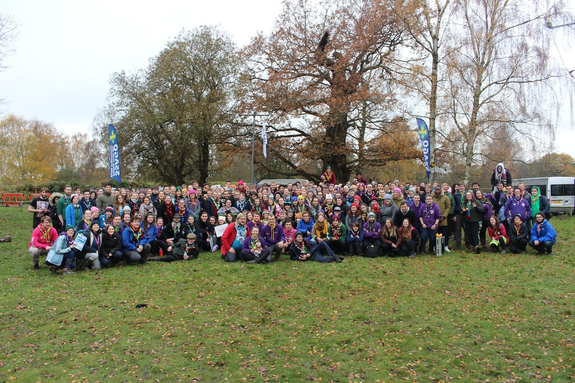
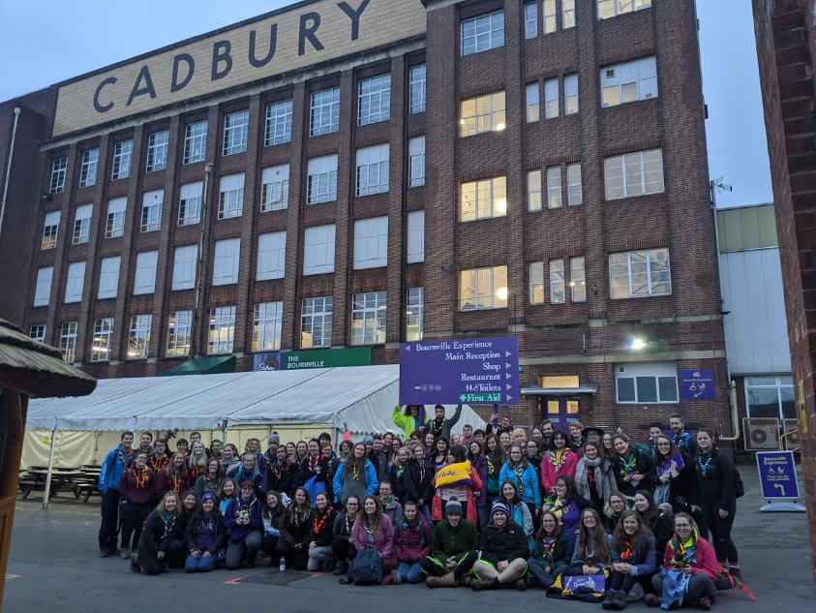
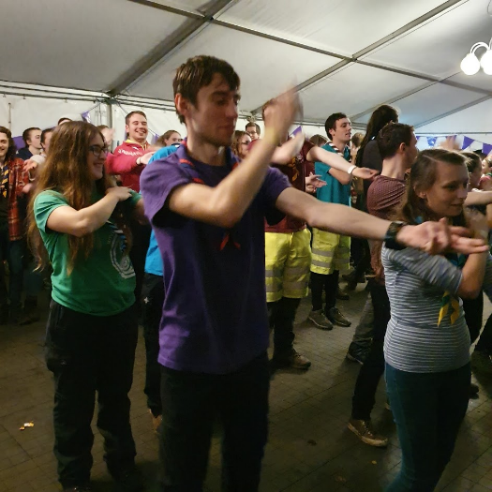
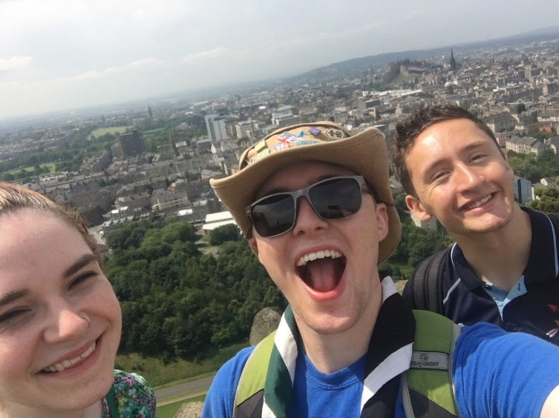
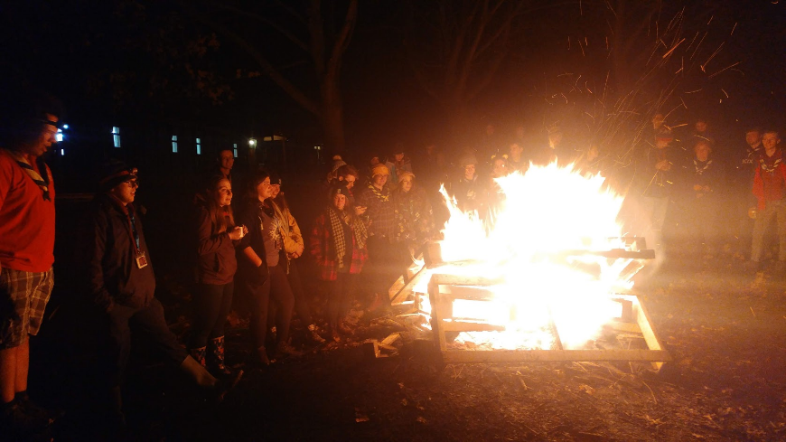
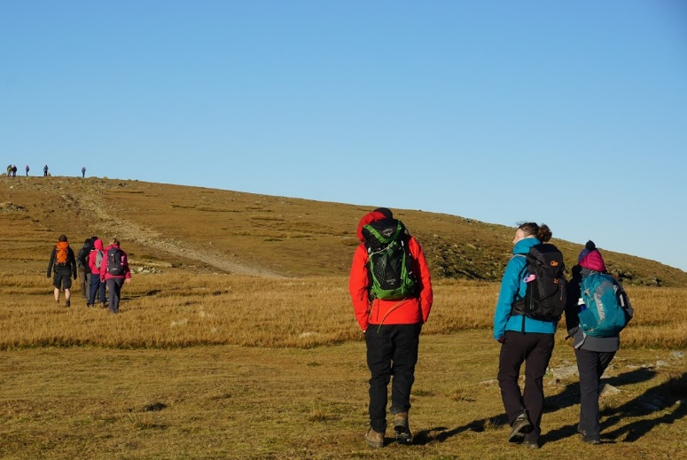
RALLIES
Notes:
Feel free to update with more up-to-date pictures

Slide 9

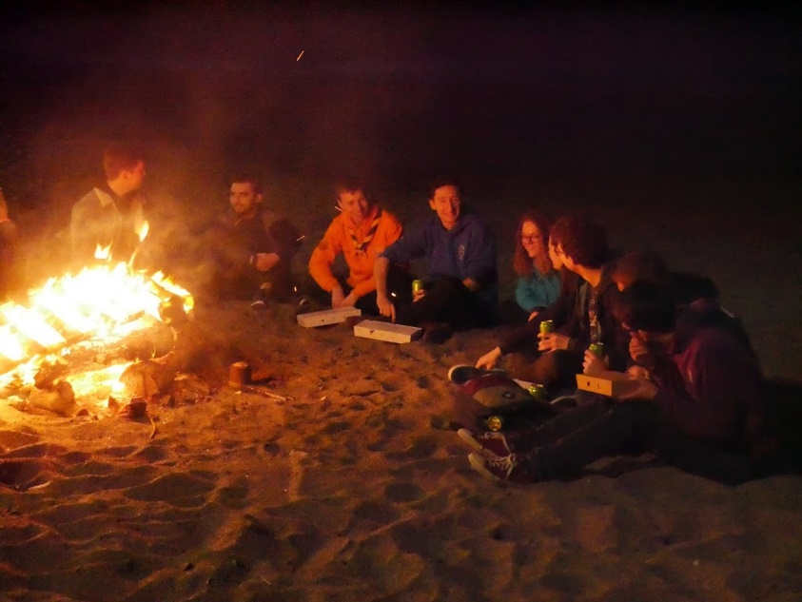
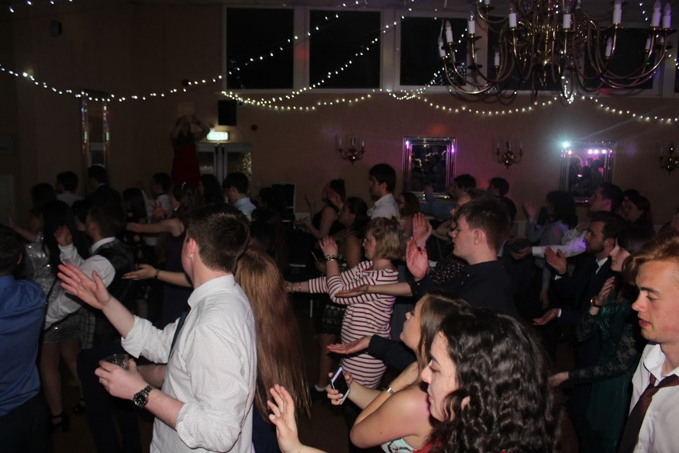
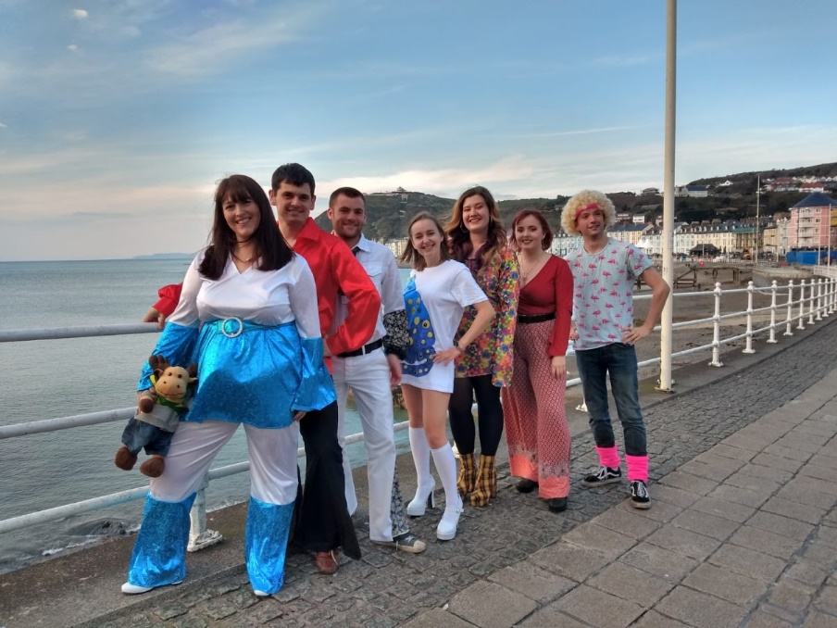
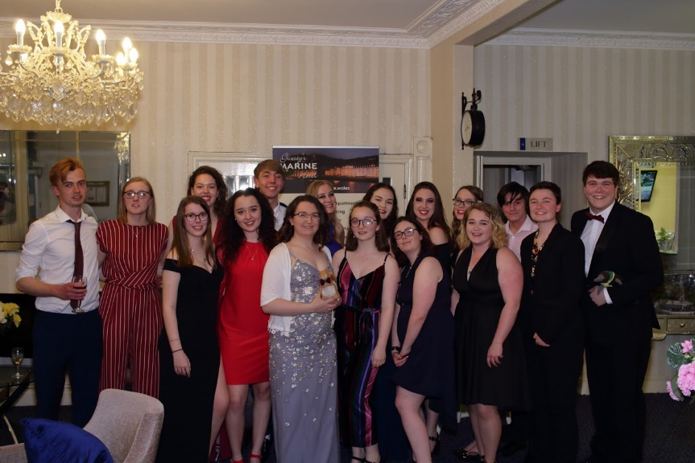
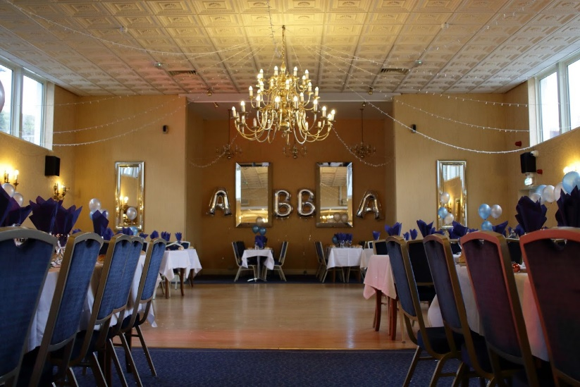
BALLS
Notes:
Feel free to update with more up-to-date pictures

Slide 10
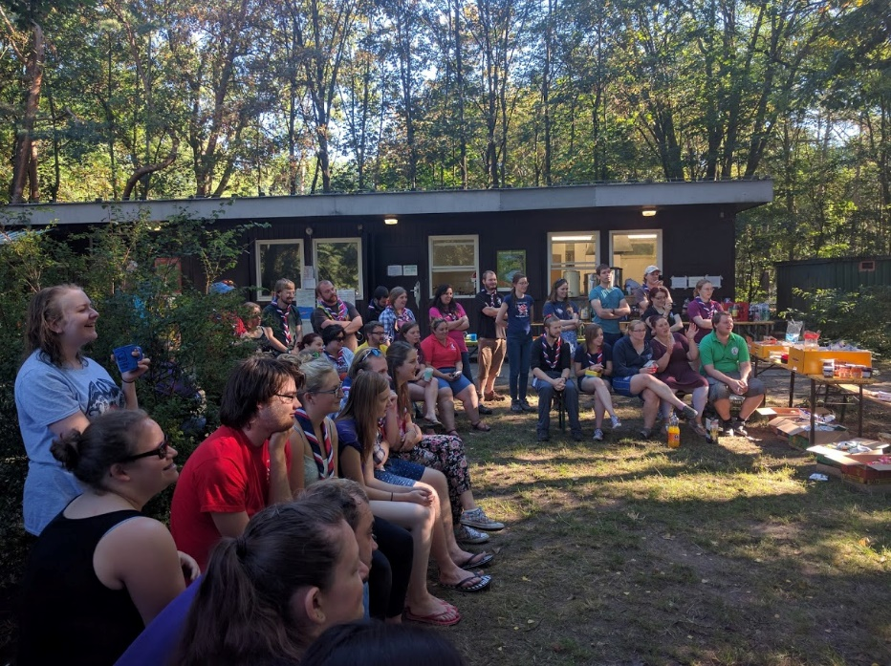


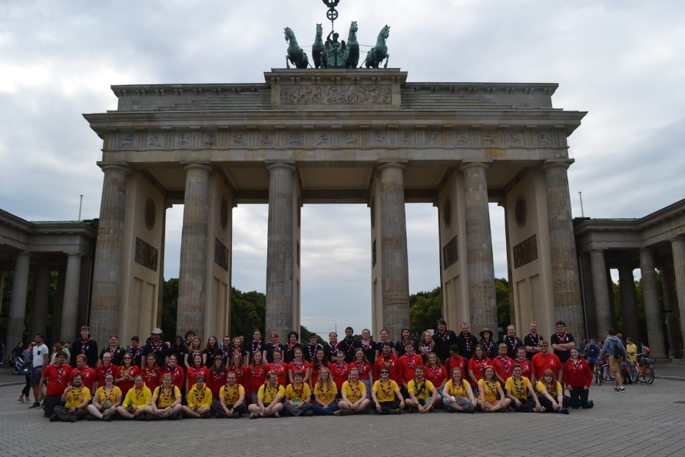
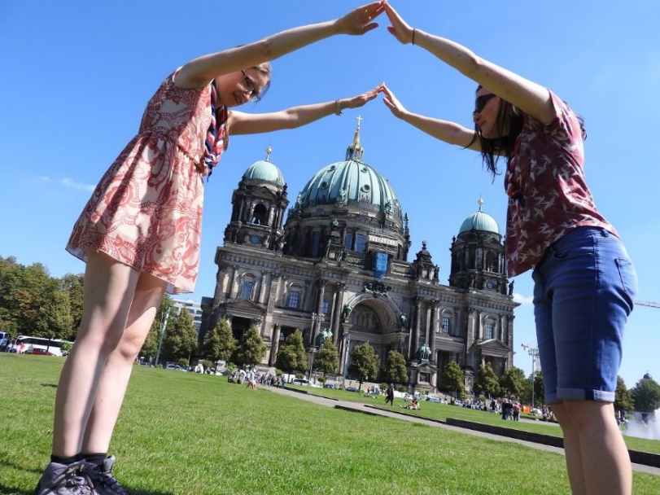
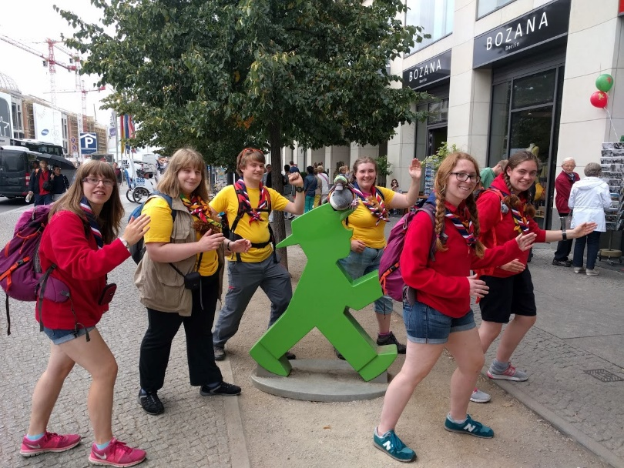
WITAN
Notes:
Last one was in Germany. Next one is to KISC in Summer 2021.

Slide 11

WEEKLY MEETINGS
Notes:
Add your own pictures of your weekly events

Slide 12













Badges At Home!
SSAGO ON LOCKDOWN
Bake Off!
Online Games!
Book Club!
Virtual Easter Egg Hunts!
SSAGO Get Active!
Sharing pet photos!
Notes:
Even during lockdown, SSAGO continues. A SSAGO discord server has been established, with a wide range of events taking place.

Slide 13



SSAGO AND SCOUTING
LOCALLY
NATIONALLY
Offers easier connections to the local Districts and Counties that will help get people involved in being a Leader at local Groups
Support at local events
Clubs provide a place for people who have an interest in completing their Top Awards
SSAGO and Network work together
SSAGO and The Scouts have a Memorandum of Agreement which dictates how we work together
Scouts provide us with guidance and assistant on important matters
SSAGO Support is a Scout Active Support Unit. We go to Scouting events such as Gilwell 24

Slide 14

SSAGO AND GUIDING
LOCALLY
NATIONALLY
Offers easier connections to the local Districts, Divisions and Counties that will help get people involved in being a Leader at local Units
Support at local events
Clubs provide a place for people who have an interest in completing their Top Awards
SSAGO and Girlguiding have a Memorandum of Agreement which dictates how we work together
Girlguiding provide us with guidance and assistant on matters
SSAGO Support is a Scout Active Support Unit. We go to Guiding events such as Wellies and Wristbands

Slide 15
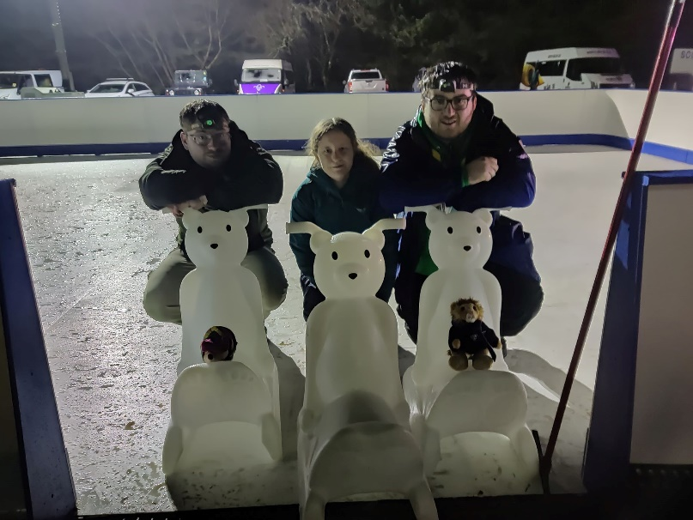
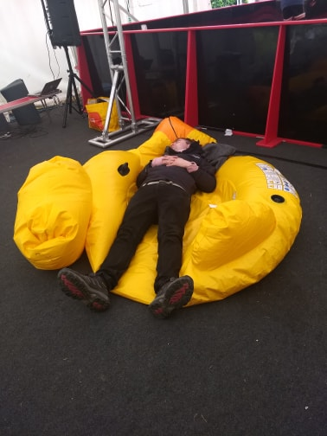
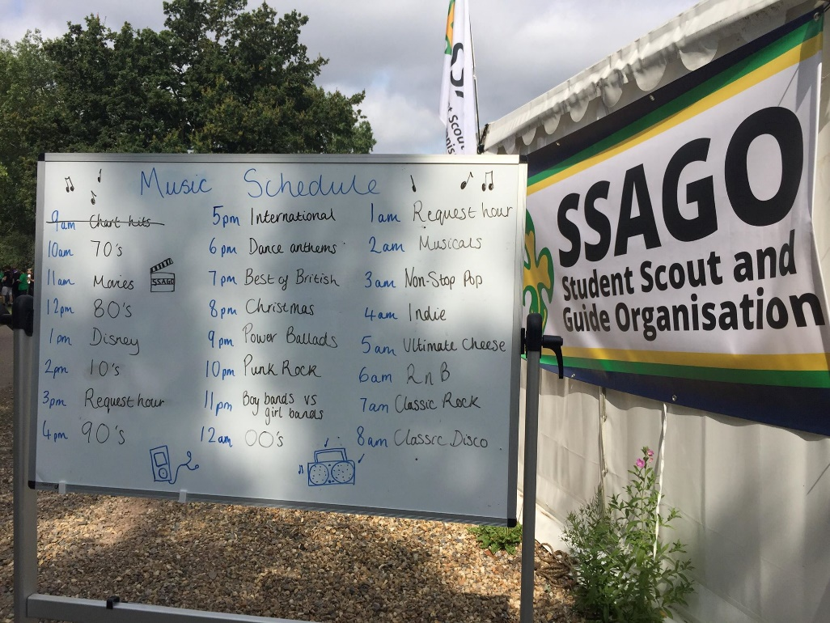
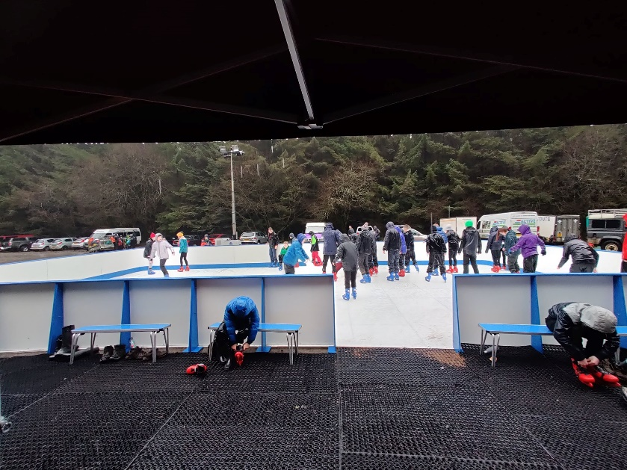
SSAGO Support
Notes:
Examples of events:
Gilwell 24
Wintercamp
Fun Days
Wellies and Wristbands
Sparkle and Ice
Etc.

Slide 16
HOW DO I SIGN UP?
STEP 1.
Head to
www.ssago.org
STEP 2.
Fill in the form
on the homepage

Slide 17
ANY QUESTIONS?
<Name>
<Club / SSAGO Exec>
<Role>
<Name>
<Club / SSAGO Exec>
<Role>
<Name>
<Club / SSAGO Exec>
<Role>
<Name>
<Club / SSAGO Exec>
<Role>
<Name>
<Club / SSAGO Exec>
<Role>
Notes:
Once again, add photos of those that are presenting / representing SSAGO

